Slide 1
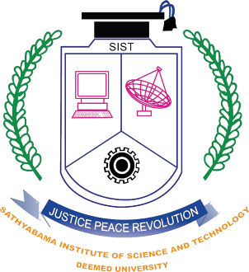
Sathyabama Institute of Science and Technology
CODEALORE Hackathon Project
Submitted by Team TechNerds comprising of Second Year Students:
Rajeev Nayan
Rahul Roonwal
Avinash Mahanthi
Sahil Gazi

Slide 2
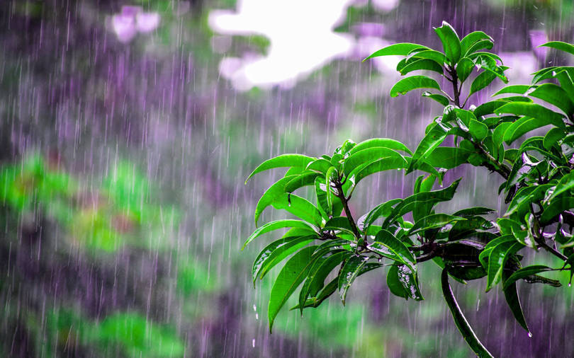
Problem Statement
Climate is an important aspect of human life. In this project we are trying to deal with the prediction of the rainfall which is a major aspect of human life and which provides the major resource of human life that is Fresh Water.

Slide 3
Why We Choose This Problem?
Fresh water is always a crucial resource of human survival – not only for the drinking purposes but also for farming, washing and many other purposes.
Due to climate change it becomes difficult for farmers to grow crops, raise animals and catch fish in the same ways and same places as they have done in the past. This also affects the agricultural production. Farmers are the main source of food for the human but due to climate change their job also gets affected. Due to climate change, availability of the fresh water is decreasing rapidly.
Rainfall is also the major resource of fresh water and rainfall is also responsible for filling up the river or lake. Ground water level is also increased only because of the rainfall. But due to the climate change, Rainfall also gets affected.
A good prediction in rainfall can lead to the better resource management.

Slide 4
Problem Solution
Several regressions and neural network-based models are currently available to observe the dataset. Indian Meteorological Department (IMD) provides statistical forecast in two stages:-
March/April
May/June
Large number of models are used for all possible combinations of predictors. But only a few models with best skills are selected. The forecast is the weighted average of the outcome of these models. The government agency, National Center for Medium Range Weather Forecasting (NCMRWF) provides daily forecasts, mainly to assist farmers.
They convert data in to the correct format to conduct experiments. Make a good analysis of data and observe variation in the patterns of rainfall. Finally, trying to predict the average rainfall by separating data into training and testing. Various statistical and machine learning approaches are used in prediction and make analysis over various approaches.

Slide 5
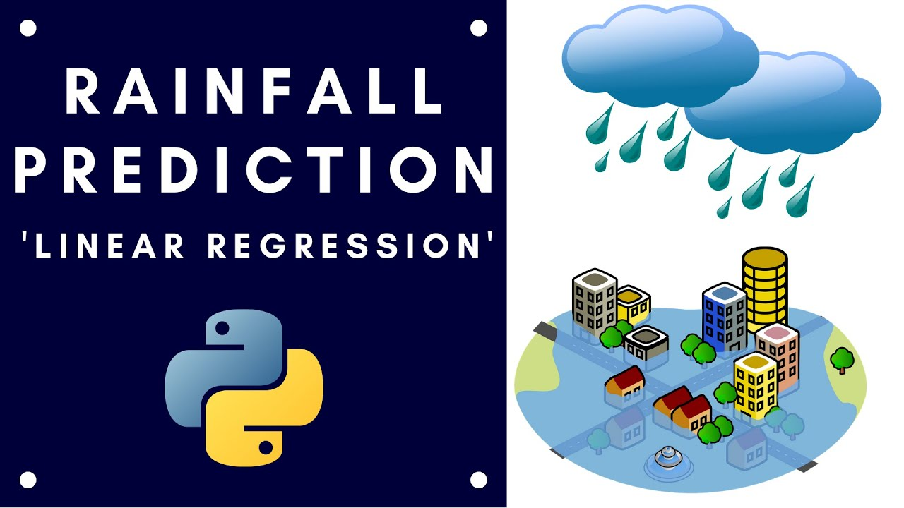

Slide 6
Our Methodology
Monsoon prediction is clearly of great importance in Tamil Nadu. Two types of rainfall predictions can be done, they are:-
● Long term predictions: Predict rainfall over few weeks/months in advance.
● Short term predictions: Predict rainfall a few days in advance in specific locations.
Indian meteorological department provides forecasting data required for this project. In this project we are planning to work on long term predictions of rainfall. The main motive of the project is to predict the amount of rainfall in Tamil Nadu well in advance. We have tried to predict the amount of rainfall using past data. We have studied various visualizations of data to observe the fluctuations and patterns in data which helps in implementing the approaches for prediction.
For prediction we formatted the data, given the rainfall in the past few years we tried to predict the rainfall in the next consecutive years. For all the experiments we used 70:30 training and test ratio. We used Mean Square Error and Root Mean Squared Error to test the model accuracy. And we used different regression algorithms like Lasso, Ridge, SVM and Random Forest to train the models.

Slide 7


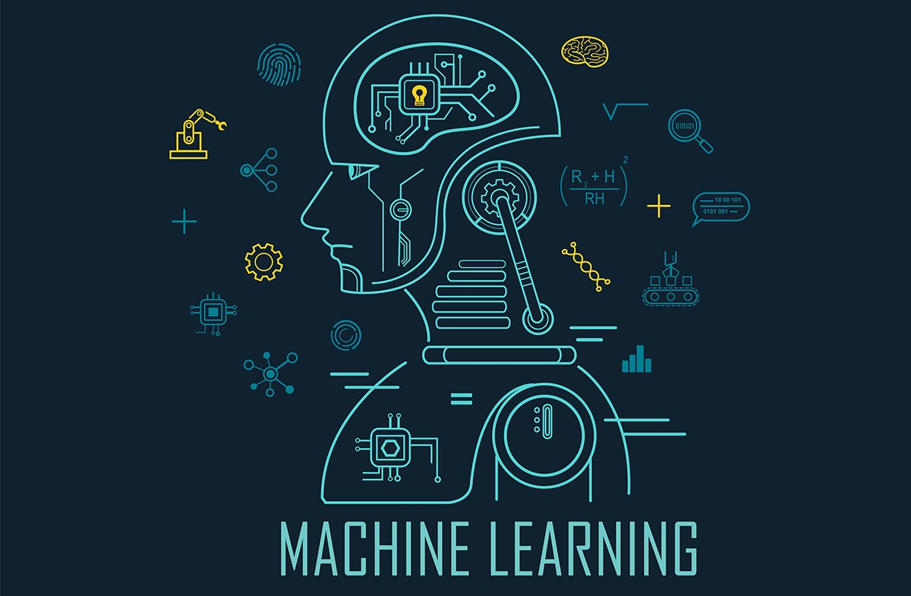


Technology Stacks Used
Jupyter Notebook
HTML
Bootstrap
Python Packages
Regression Algorithms

